Slide 1
Command & Visitor Patterns
by Taras Yatsyshyn Lv-273.Net

Slide 2
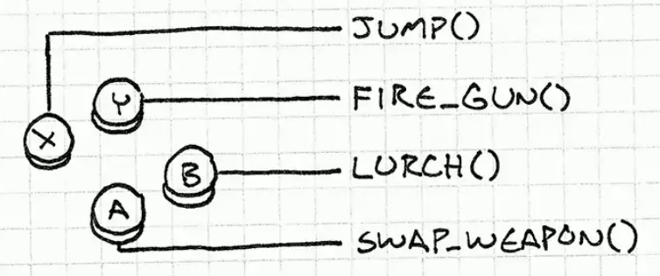
Command pattern
Command Pattern - allows you to submit a request as an object, allowing the client configuring the request (setting parameters for processing it), queuing queries, log requests, and support the cancellation of transactions.

Slide 3
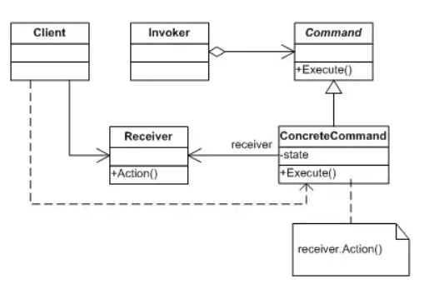
UML
Notes:
The classes and objects participating in this pattern are:
Command
declares an interface for executing an operation
ConcreteCommand
defines a binding between a Receiver object and an action
implements Execute by invoking the corresponding operation(s) on Receiver
Client
creates a ConcreteCommand object and sets its receiver
Invoker
asks the command to carry out the request
Receiver
knows how to perform the operations associated with carrying out the request.

Slide 4

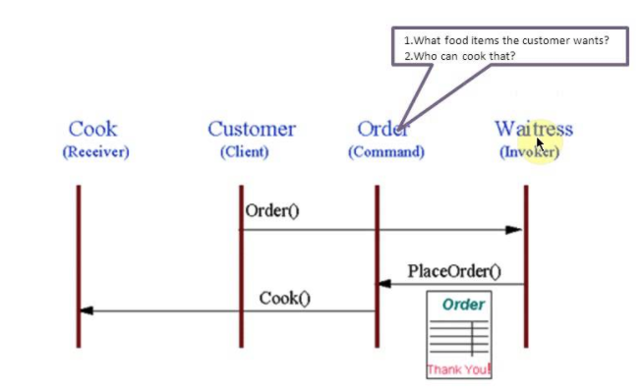
In Life
Notes:
The Command pattern allows requests to be encapsulated as objects, thereby allowing clients to be parameterized with different requests. The "check" at a diner is an example of a Command pattern. The waiter or waitress takes an order or command from a customer and encapsulates that order by writing it on the check. The order is then queued for a short order cook. Note that the pad of "checks" used by each waiter is not dependent on the menu, and therefore they can support commands to cook many different items.
https://refactoring.guru/ru/design-patterns/command

Slide 5
Example

Slide 7
Examples in .Net
ICommand in WPF, on the basis of which the binding of operations to events of the user interface is constructed;
IDbCommand in ADO.NET encapsulates an operation executed on the DBMS side;

